Slide 1
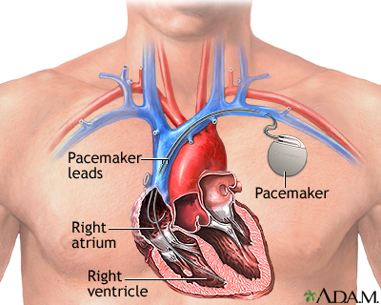
Pacemaker Vulnerability:
How Medical Technology and Biological Augmentation
Create New Vulnerabilities
By:
James Waugh, Megan Clark, Elizabeth Hubbard, Daniel Elice

Slide 2
Problem Statement
Medical Technology is very important and is able to keep many people alive today using advanced technology. People require these technologies such as pacemakers and insulin pumps in order to survive.
With this newer technological advances this opens up room for more vulnerabilities. Most of these medical devices require a network connection that is able to help this device work such as insulin pumps being able to add insulin remotely over a network or pacemakers being able to send data information over the network to the doctor.
With these devices however it was never considered about what if people wanted to attack these devices? Even though they are meant to help people, there are always attackers that are trying to exploit systems, so since these devices do not have security measures this is allowing an attacker to get access into these devices.

Slide 3

Motivation
One motivation for this project is that one of our group member’s grandfather currently has a pacemaker, but it is getting close to the time for it to be replaced. Since there have been technological developments in the last 10 years when he got his current device, he now has an option to keep the same type, or to pick a new pacemaker wherein information could be directly transmitted to the doctor. This can decrease the amount of time in which both the doctor and the patient have to meet in person.
Another motivator for this project was the Insulin Pump Vulnerability demonstrated in class. By being made aware of one type of medical device vulnerable to hacking, we were curious about what other medical devices were also vulnerable. We decided on the pacemaker, since it is such an important device.

Slide 4
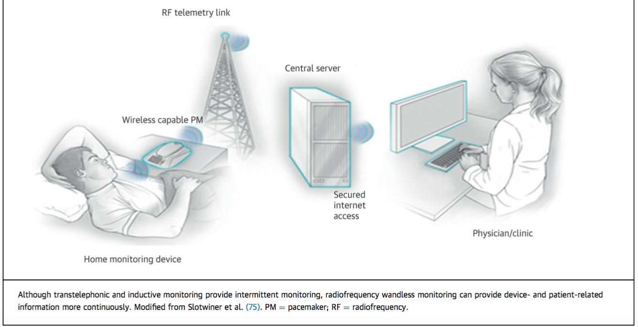
Background Research
For this project even though there are many different types of pacemakers and ways they communicate back to the doctor, we chose to simulate and research the RF telemetry link pacemaker.
This device communicates between the pacemaker, a home transmitter, the central server, and the doctor. The home transmitter is the device that collects data from the pacemaker and the central server is where the patient’s data is being sent.

Slide 5
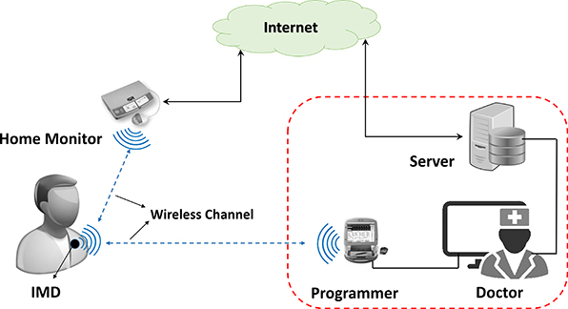
Pacemaker-Database Communication Visual Graphic

Slide 6
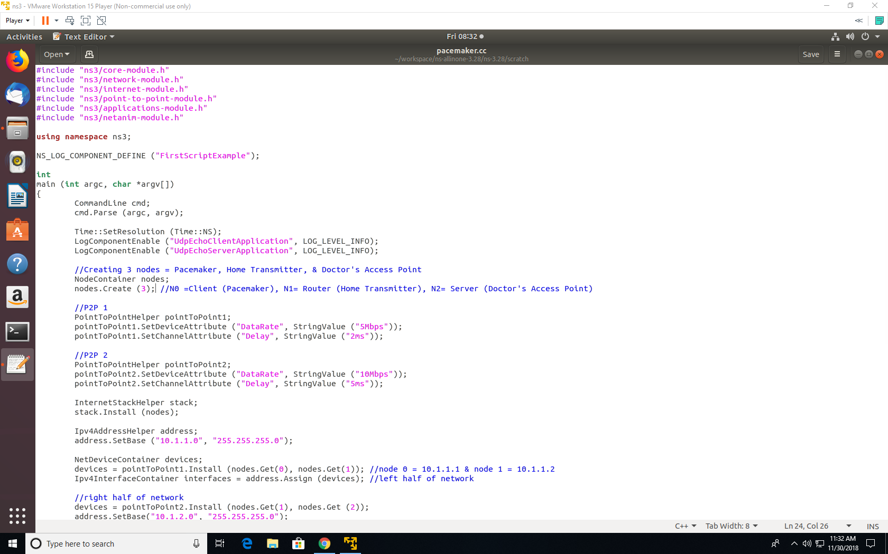
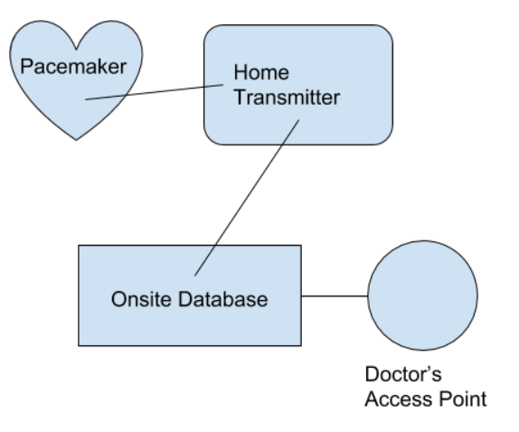
Setting Up the Connection to NS3

Slide 7
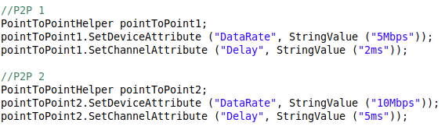
Setting Up the Connection to NS3 (continued)
Point to Point Protocol
Data link layer communication
Used to establish a direct connection between two nodes

Slide 8


Setting Up the Connection to NS3 (continued)

Slide 9
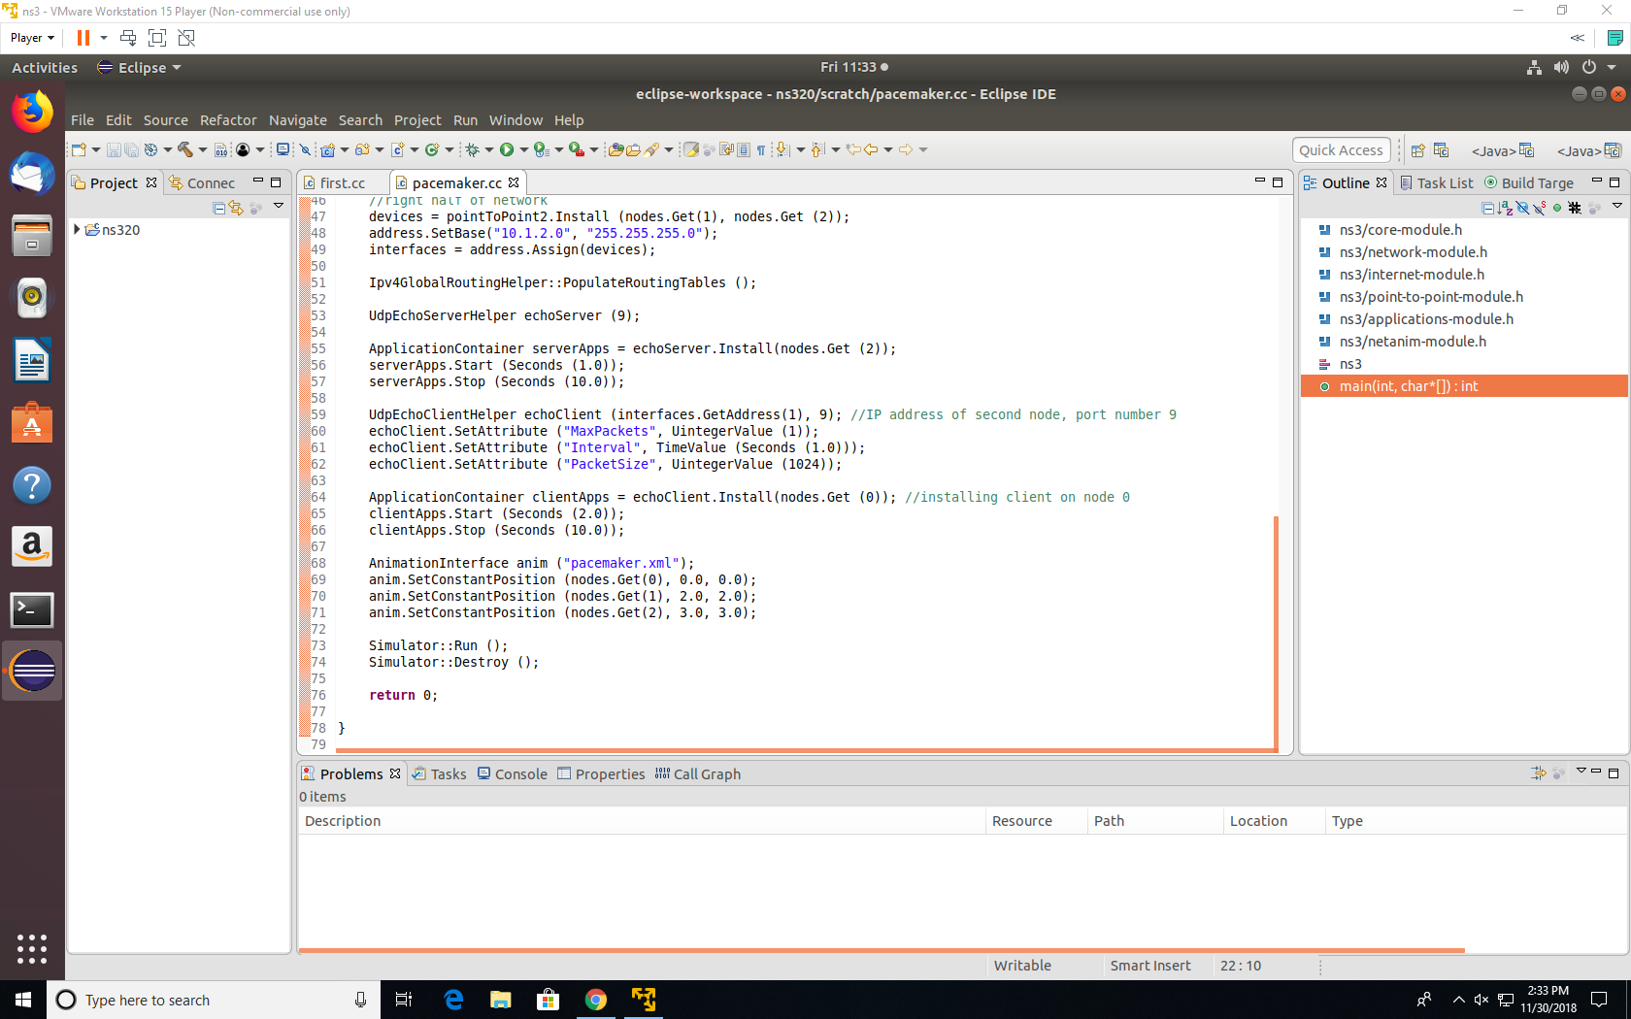
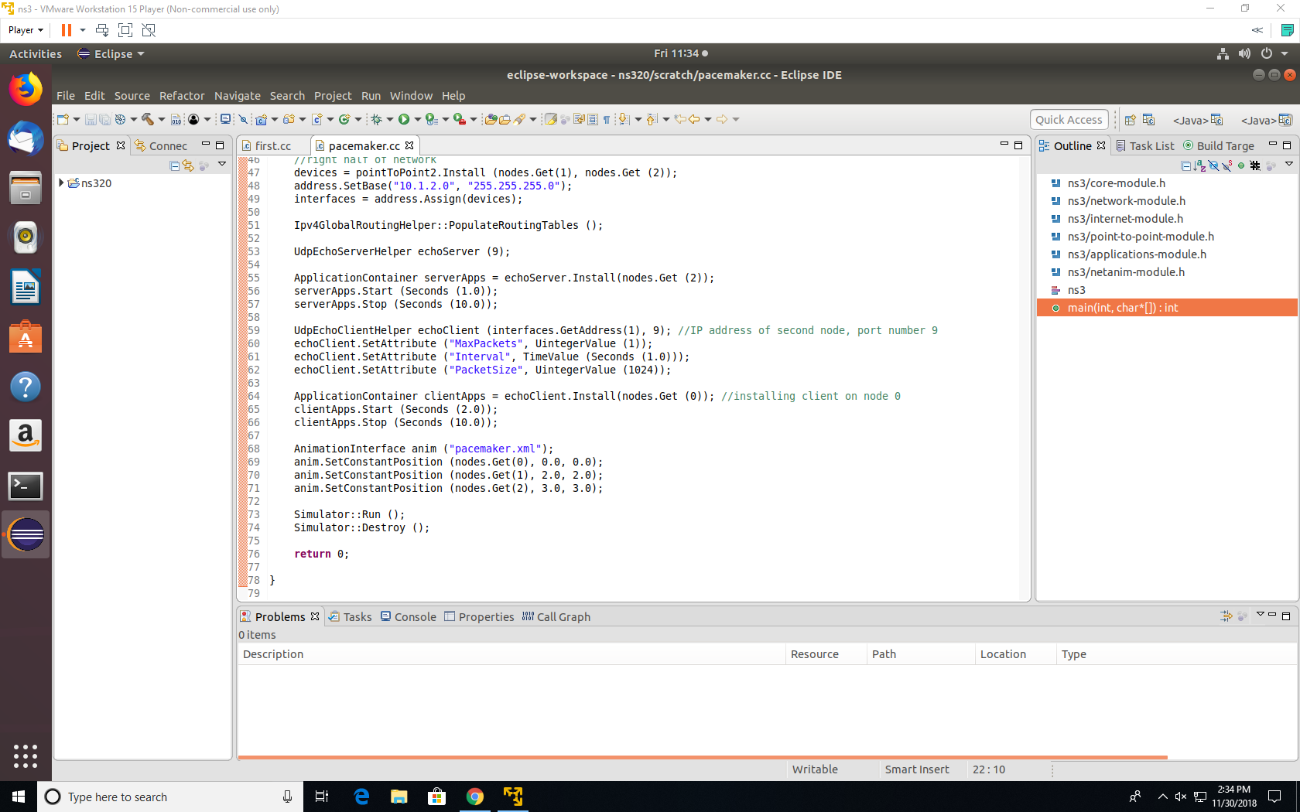
Setting Up the Connection to NS3 (continued)

Slide 10
Referenced Approach
Two researchers, Billy Rios and Jonathan Butts, have researched different vulnerabilities that exist on Medtronic's pacemakers.
The first problem they found was not with the direct transmission of the information from the pacemaker to the doctor, but instead from the software delivery network. This is how devices involved directly with the pacemaker receive updates, “which healthcare professionals use to tune implanted pacemakers” [7].
The researchers had given the information they had found through their research and their simulated environment to the company, but instead of solving the issues, the company “took 10 months to vet the submission, at which point it opted not to take action to secure the network”[7].
An attacker could use the exploit to control implanted pacemakers remotely, delivering or withholding shocks to patients to cause direct harm to their bodies.

Slide 11
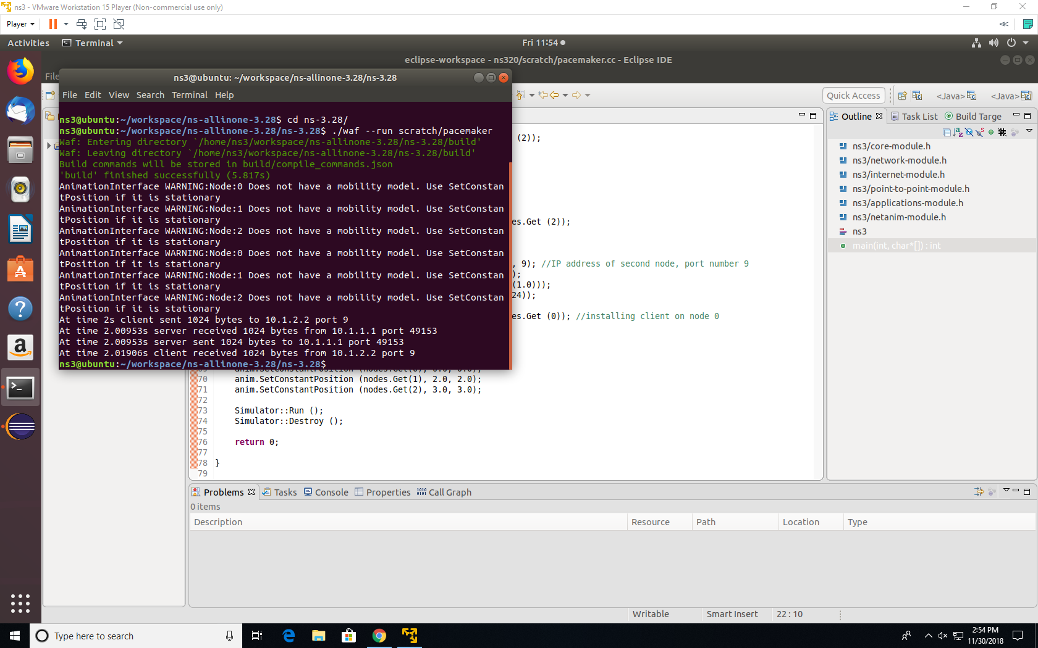
Attacking Communication in NS3

Slide 12
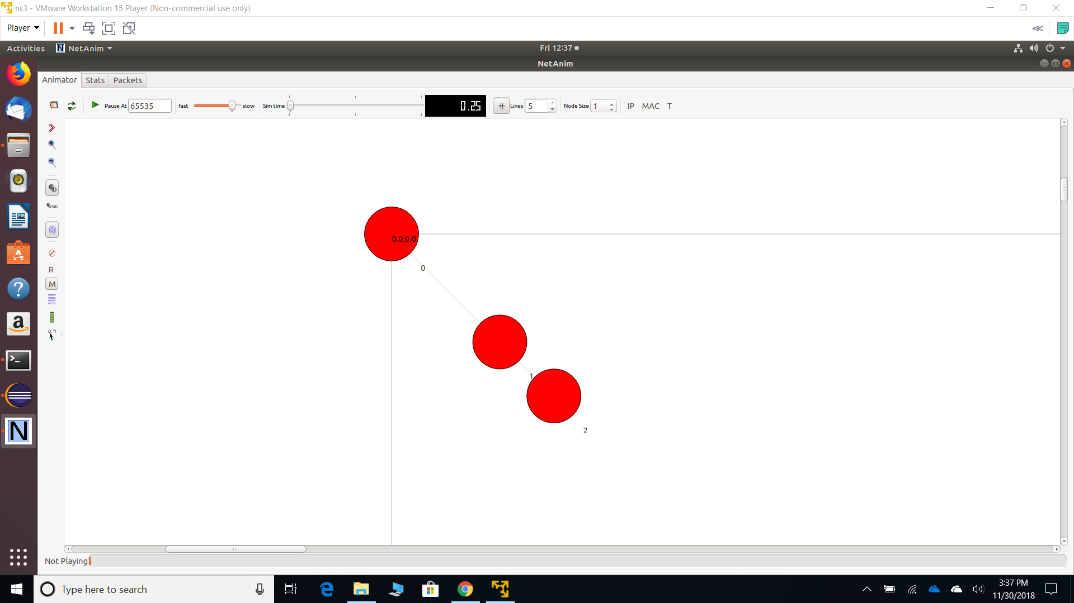

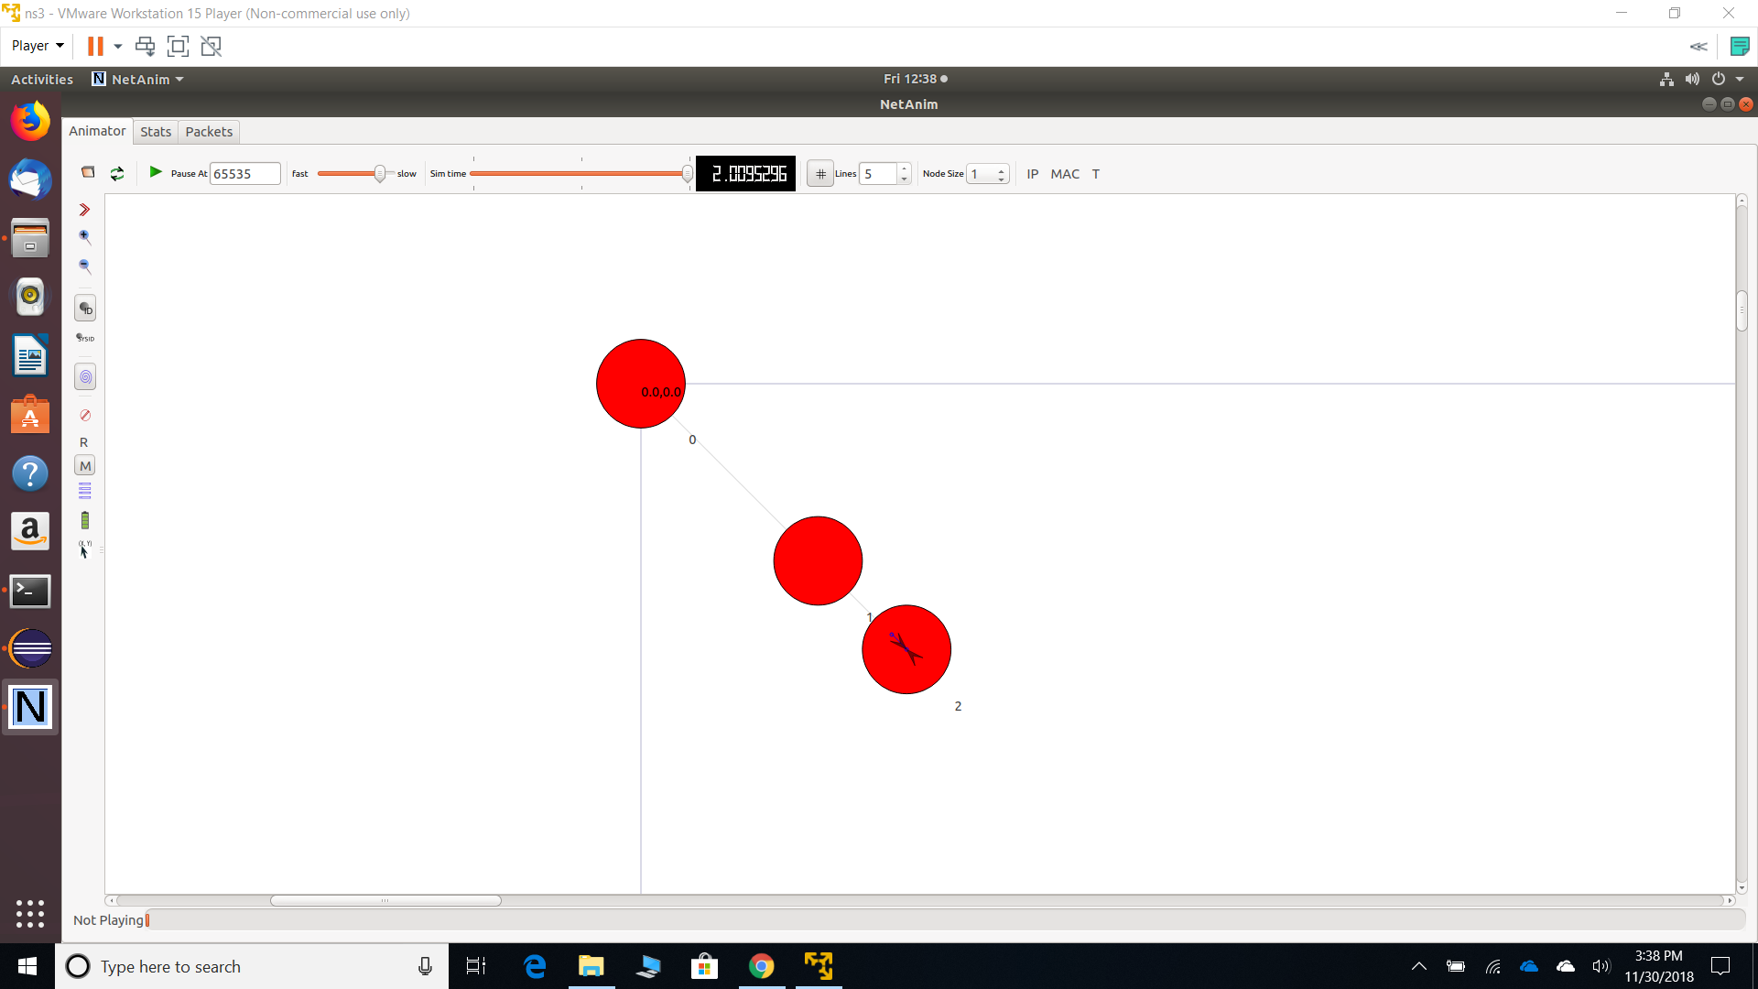


Attacking Communication in NS3
t=0.00 t = 2.002 2.00953 t=2.0153 t=2.019

Slide 13
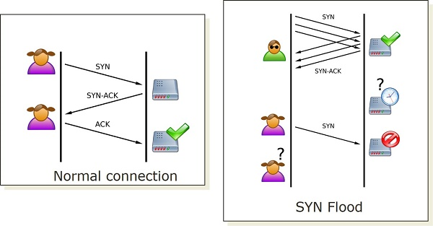
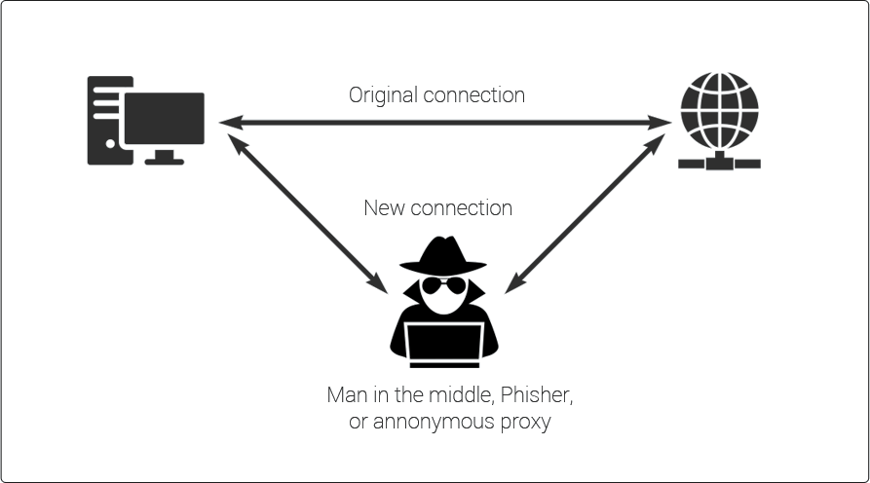
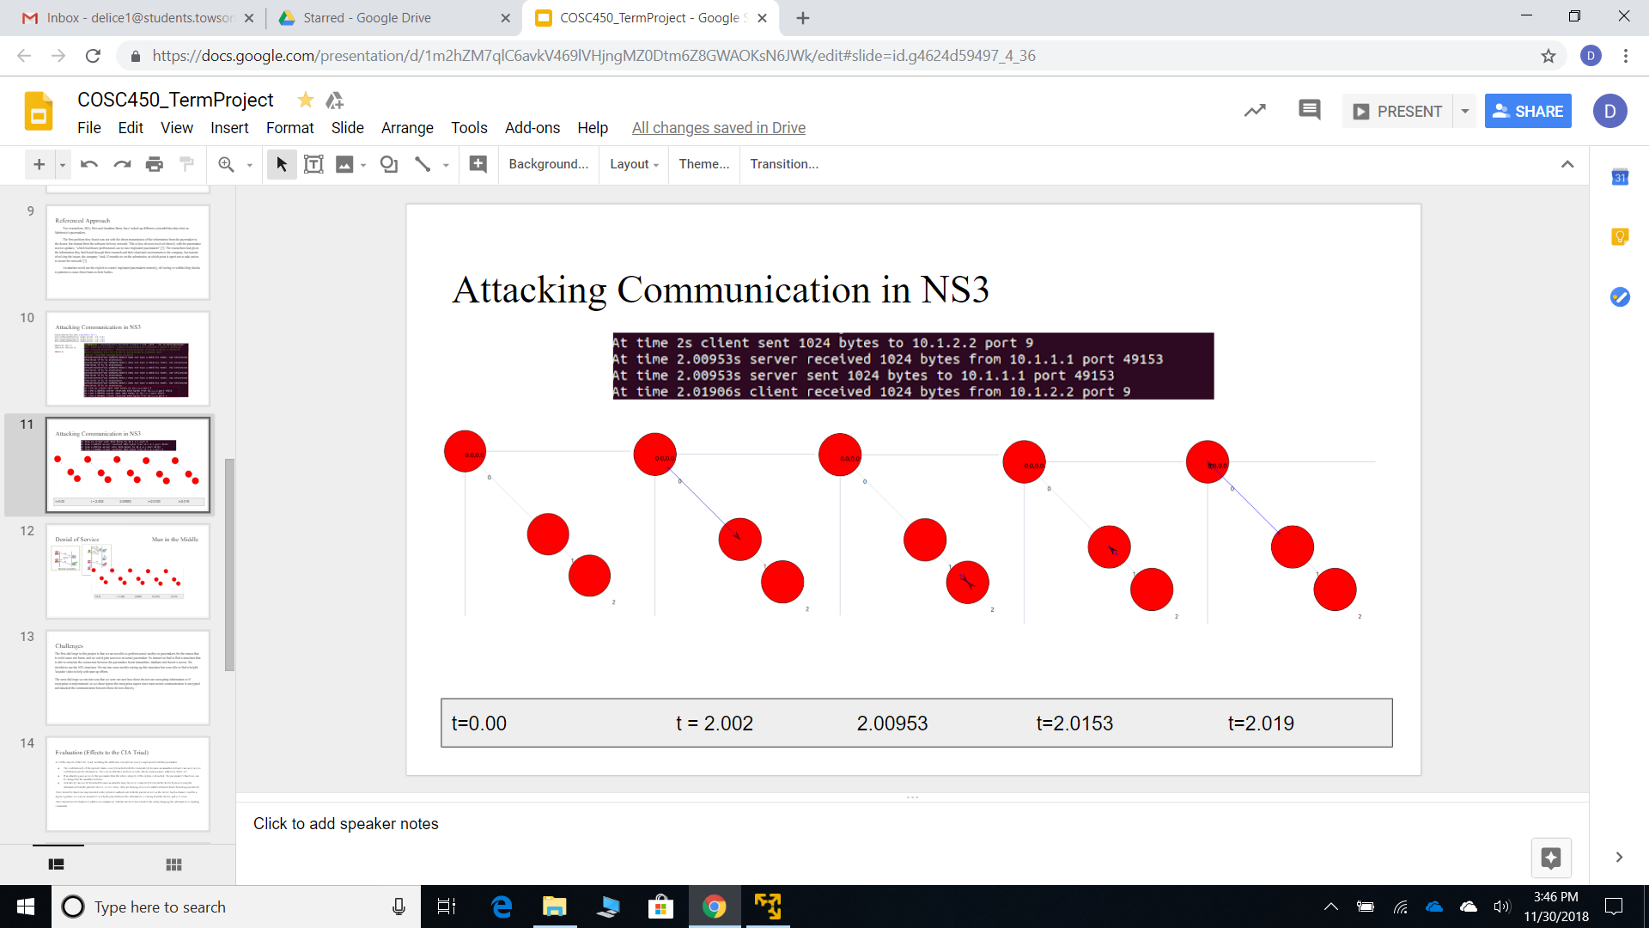
Denial of Service Man in the Middle

Slide 14
Solution
Companies need to implement ways to defend against attacks
DoS - Load Balancer→ limits can be assigned so that if an attack occurs, the load balancer can drop the connection that are exceeding the values
MITM - Authentication certificates → automated certificates verifying information is authentic. Encryption of information.

Slide 15
Challenges
The first challenge in this project is that we are not able to perform actual studies on pacemakers for the reason that it could cause real harm, and we could gain access to an actual pacemaker.
Instead we had to find a simulator that is able to simulate the connection between the pacemaker, home transmitter, database and doctor’s access. We decided to use the NS3 simulator.
We ran into some trouble setting up this simulator but were able to find a helpful Youtube video to help with start up efforts.
We ran into was that we were not sure how these devices are encrypting information or if encryption is implemented, so we chose ignore the encryption aspect since most secure communication is encrypted and attacked the communication between these devices directly.

Slide 16
Evaluation (Effects to the CIA Triad)
All of the aspects of the CIA Triad, including the additional concepts are easily compromised with the pacemaker.
The confidentiality of the patient’s data is easily breached with this vulnerability because an unauthorized user can easily access confidential patient information. This can include their medical records, which contain names, addresses, SSNs, etc.
If an attacker gains access to the pacemaker then the whole integrity of the system is breached. The pacemaker’s functions can be changed by the unauthorized user
Availability can also be breached because an attacker may choose to completely block out the doctor from accessing the information from the patient’s device, or vice versa. They are denying services to authorized users hence breaching availability.
There should be functions implemented in the system to authenticate both the patient as well as the doctor. Such a feature could be a digital signature or a similar measure to verify the patient knows the information is coming from the doctor, and vice versa.
There should also be features to address accountability, with the ability to trace back to the entity changing the information or inputting commands.

Slide 17
Analysis and Inferences
The attacker may gain access to the hospital network to intercept packets sent to and from the home transmitter. As a number of recent reports reveal, hospitals are notoriously unprepared for malicious attacks on their network, as they utilize outdated security measures and operating systems.
It can be inferred that medically implanted devices similar to pacemakers will inherit vulnerabilities of this nature as long as they are transmitting information wirelessly.
However, it might be within a manufacturer’s interests to increase the quality of their system security so that attacks on patients that cause harm or death do not lead to aggressive lawsuits.
Failure to comply with security standards for medically implanted devices associated with vital bodily processes would surely lead to public outcry and politically motivated legal action.

Slide 18
Conclusion
Pacemakers do not have the appropriate level of security in order to deem these medical devices safe for users.
Although these are necessary devices in order to keep people with these devices alive, the newer versions that communicate wirelessly should be reviewed for addition security measures, which would impede attackers trying to gain access these devices.
The older pacemaker models are more secure.
However, the issue with the older devices is that doctors are not able to see and respond to problems as quickly, since they usually have 3 month-interval checkups.

Slide 19
Future Direction
We would want to test out more medical devices to see if they are just as vulnerable. Since this is now the second medical device we know of that does not have integrated security measures, we are going to assume there are many more medical devices out there with these same security problems.
Companies that produce these devices need to have regulations to ensure their products are secure for their customers. These regulations need to be implemented to provide the necessary security needed so that these devices are not compromised.

Slide 20
References
[1] Choudhary, H. (2014, November 24). Retrieved November 12, 2018, from https://www.youtube.com/watch?v=T8NwCPROYYA
[2] Hamlyn-Harris, J. H. (2018, September 19). Three reasons why pacemakers are vulnerable to hacking. Retrieved from http://theconversation.com/three-reasons-why-pacemakers-are-vulnerable-to-hacking-83362
[3] Hern, A. (2018, August 9). Retrieved November 16, 2018, from https://www.theguardian.com/technology/2018/aug/09/implanted-medical-devices-hacking-risks-medtronic
[4] Ilov, N., Abdulkadyrov, A., & Nechepurenko, A. (2016). Early detection of defibrillator lead failure by Medtronic Carelink remote monitoring. Annaly Aritmologii,13(1), 55-58. doi:10.15275/annaritmol.2016.1.7 https://www.medtronic.com/content/dam/medtronic-com/us-en/corporate/documents/Medtronic_2090_Security_Bulletin_02272018.pdf
[5] Madhavan, M., Mulpuru, S. K., Cha, C. J., & Friedman, P. A. (2017, January 09). Advances and Future Directions in Cardiac Pacemakers. Retrieved from http://www.onlinejacc.org/content/69/2/211
[6] Medtronic enables pacemaker monitoring by smartphone. (2015, November 20). Retrieved from https://www.healthcareitnews.com/news/medtronic-enables-pacemaker-monitoring-smartphone
[7] Newman, L. H. (2018, August 09). A New Pacemaker Hack Puts Malware Directly on the Device. Retrieved from https://www.wired.com/story/pacemaker-hack-malware-black-hat/
[8] ICS- CERT Medtronic Search https://search.usa.gov/search?utf8=✓&affiliate=us-cert-ics&query=Medtronic&commit=Search
[9] Pacemaker. (2018, March 21). Retrieved from https://www.mayoclinic.org/tests-procedures/pacemaker/about/pac-20384689
[10] Pacemakers market volume worldwide in units 2023 forecast | Statistic. (n.d.). Retrieved from https://www.statista.com/statistics/800794/pacemakers-market-volume-in-units-worldwide/
[11] ns-3: ns3::MinstrelHtWifiManager Class Reference. [Online]. Available: https://www.nsnam.org/doxygen/classns3_1_1_udp_echo_server_helper.html#details. [Accessed: 30-Nov-2018].

